Slide 1
Station Plot and Instrumentation Review
AOSC200 – 0201, 0103
TA: Hannah Daley
atmos.umd.edu/~hmdaley/AOSC200/

Slide 2
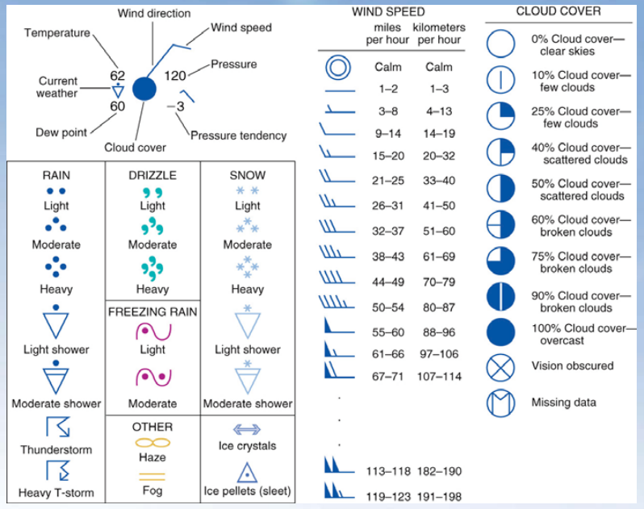
Weather Station Model
For quizzes and Exams you should know:
Dew point ≤ Temp
100% relative humidity: Dew Point=Temp
General sense of fastest wind speeds
General sense of cloud coverage
DO NOT MEMORIZE CURRENT WEATHER
Determine atmospheric pressure in 3 easy steps:
Move the decimal once to the left 120→12.0
If value is less than 50, add 10 to the front 12.0→1012.0 mbar
If value is greater than 50, add 9 to front

Slide 3
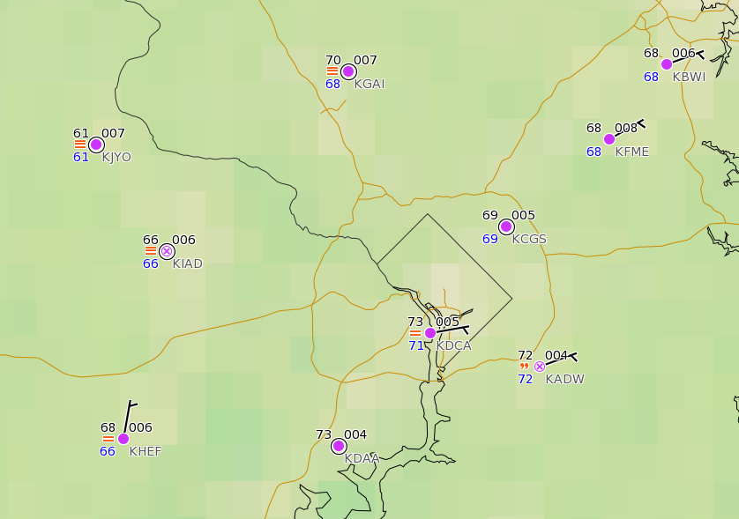
Station Plot Examples
College Park Airport (KCGS)
Temperature:
Dew Point:
Pressure:
Wind:
Wind Direction:
Sky Cover:
Weather:
69°F
69°F
1000.5 mb
calm
N/A
overcast
N/A

Slide 4
Station Plot Examples
Reagan Int’l (KDCA)
Temperature:
Dew Point:
Pressure:
Wind:
Wind Direction:
Sky Cover:
Weather:
73°F
71°F
1000.5 mb
~5 kts
ENE
overcast
fog

Slide 5
Station Plot Examples
Andrews AFB (KADW)
Temperature:
Dew Point:
Pressure:
Wind:
Wind Direction:
Sky Cover:
Weather:
72°F
72°F
1000.4 mb
~5 kts
ENE
obscured
light drizzle

Slide 6
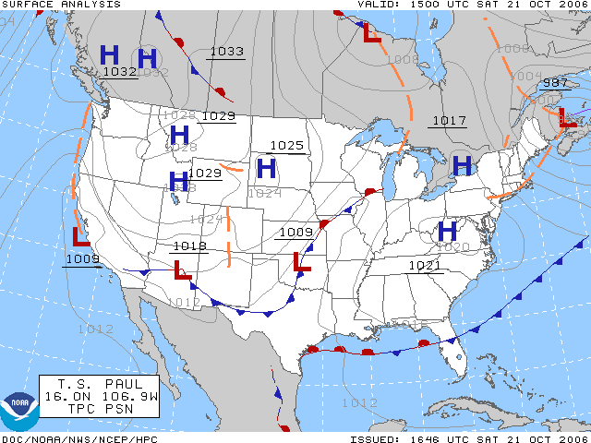
Weather Map Basics- Surface Pressure Types
High Pressure (H):
Associated with stagnant and hot conditions
Low Pressure (L):
Associated with fronts and stormy conditions

Slide 7
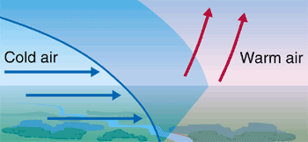
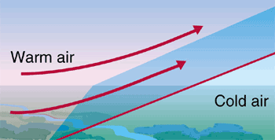
Weather Map Basics- Cold vs Warm Front
For quizzes and exams you should know:
Color AND Shape of warm and cold fronts
Which direction to draw arrows based off temperatures
Pressure associated at the edge of fronts

Slide 8
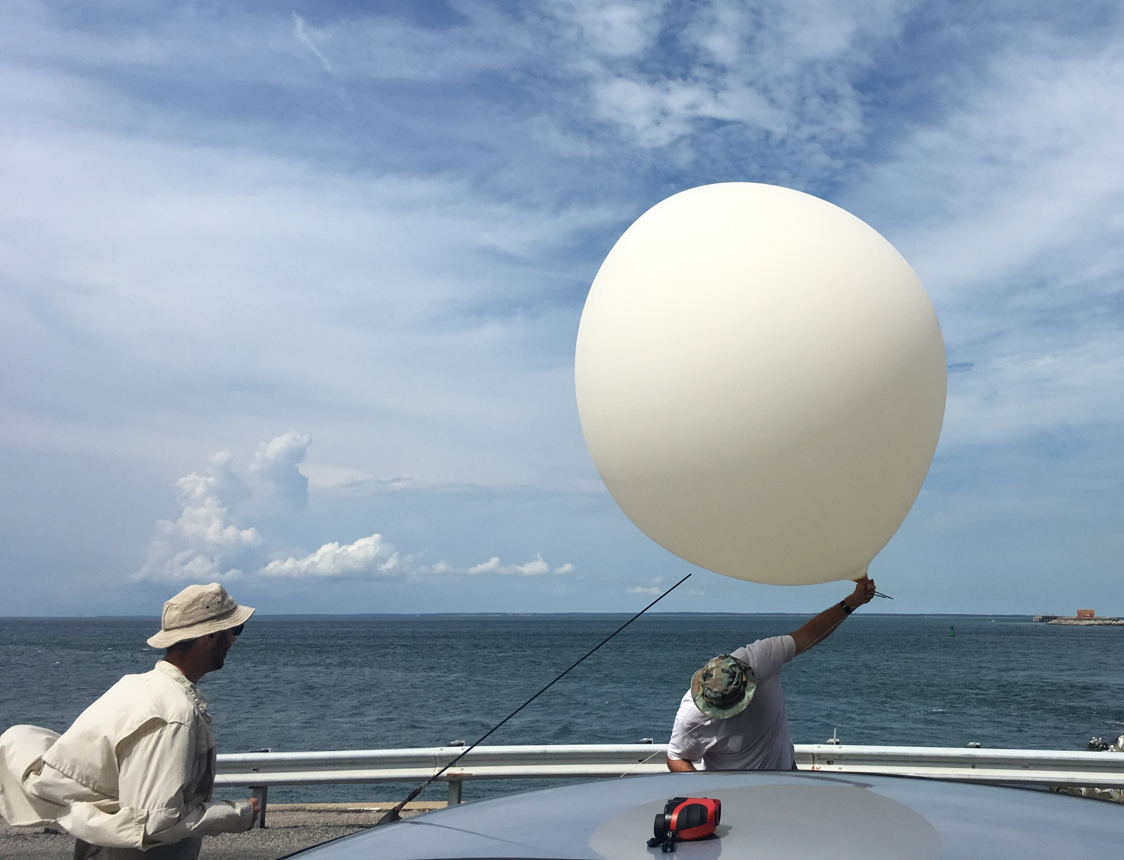
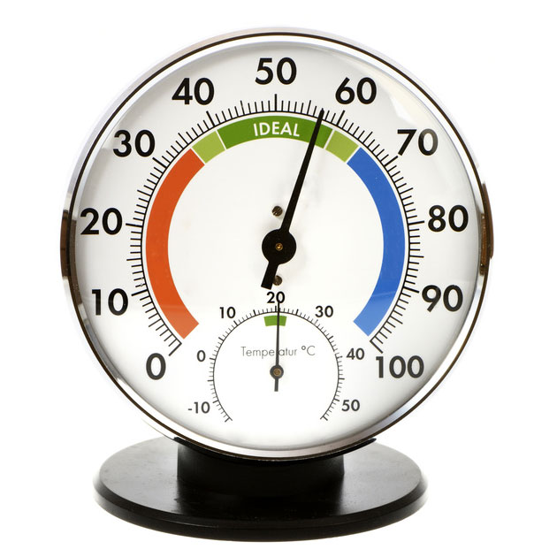
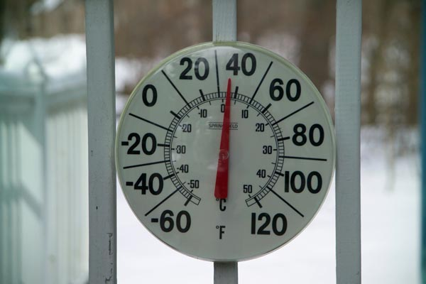
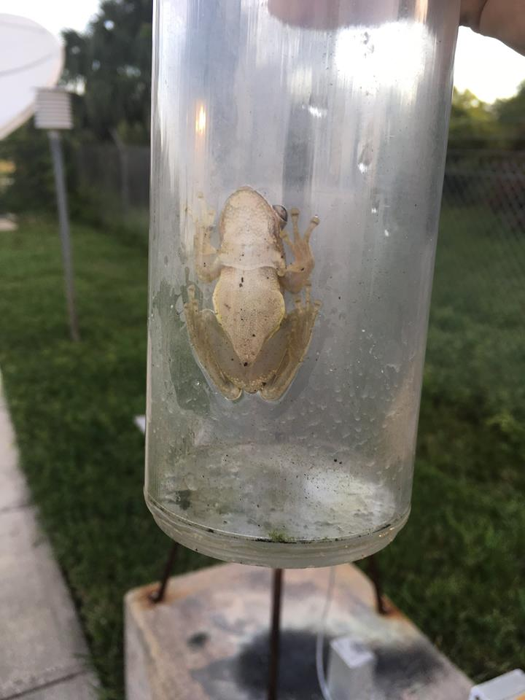
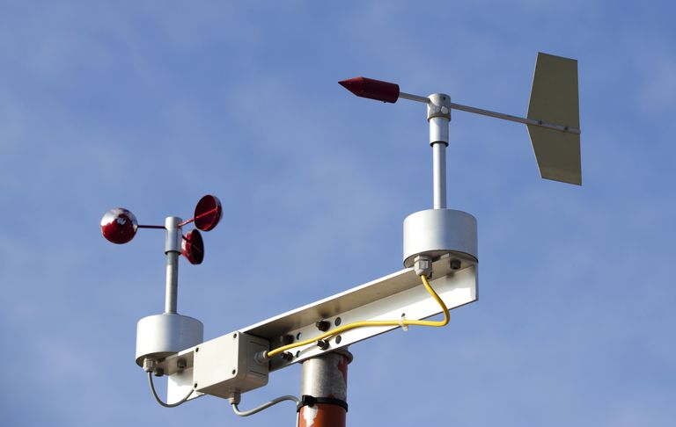
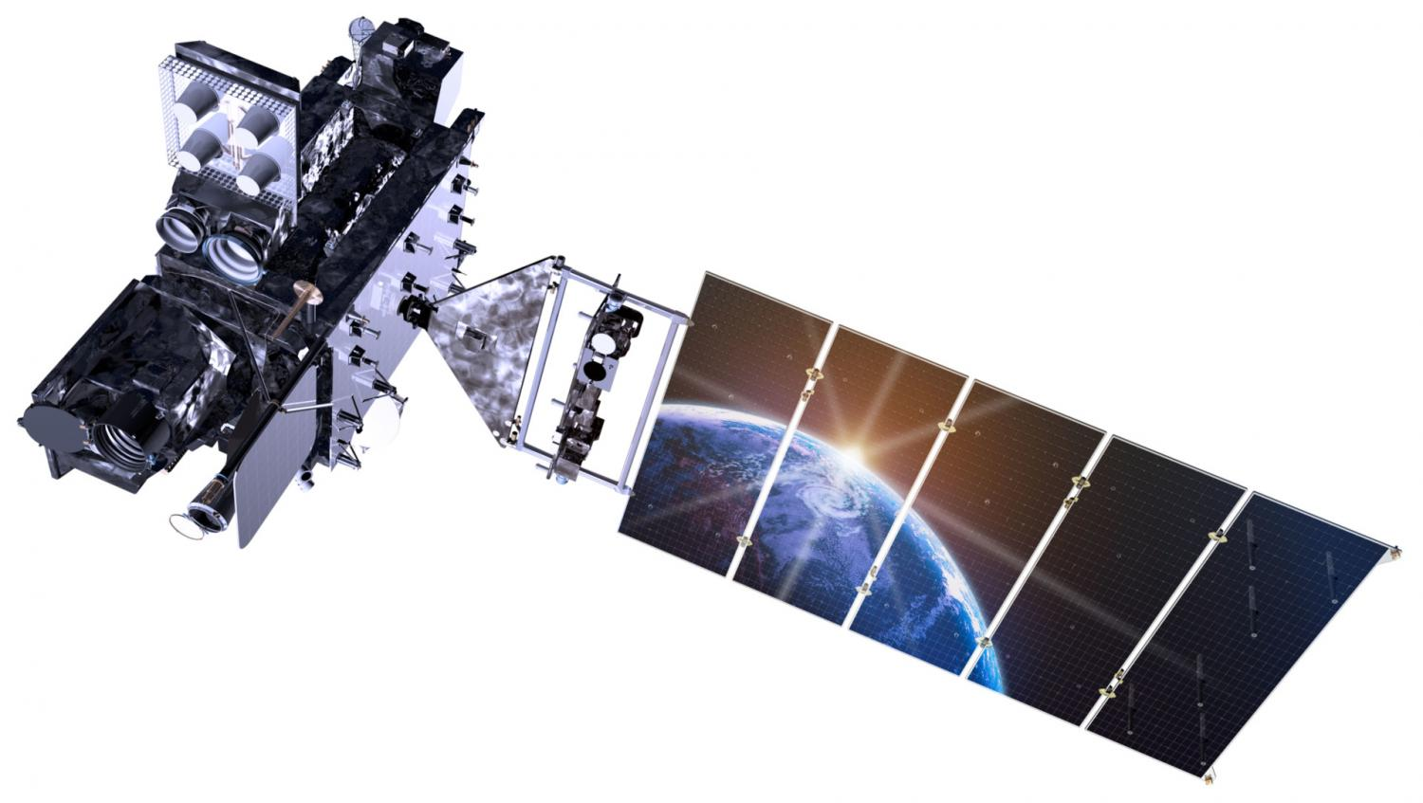
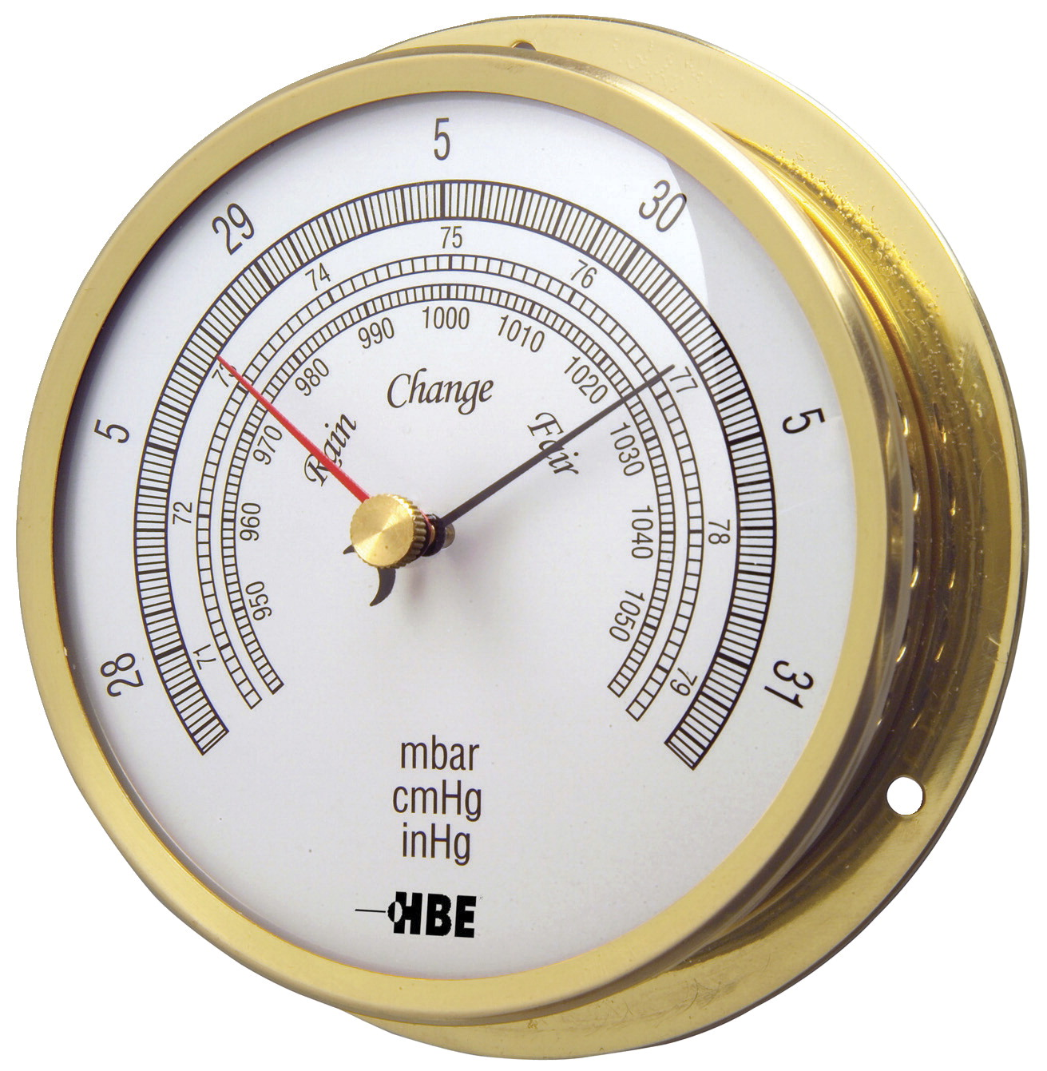
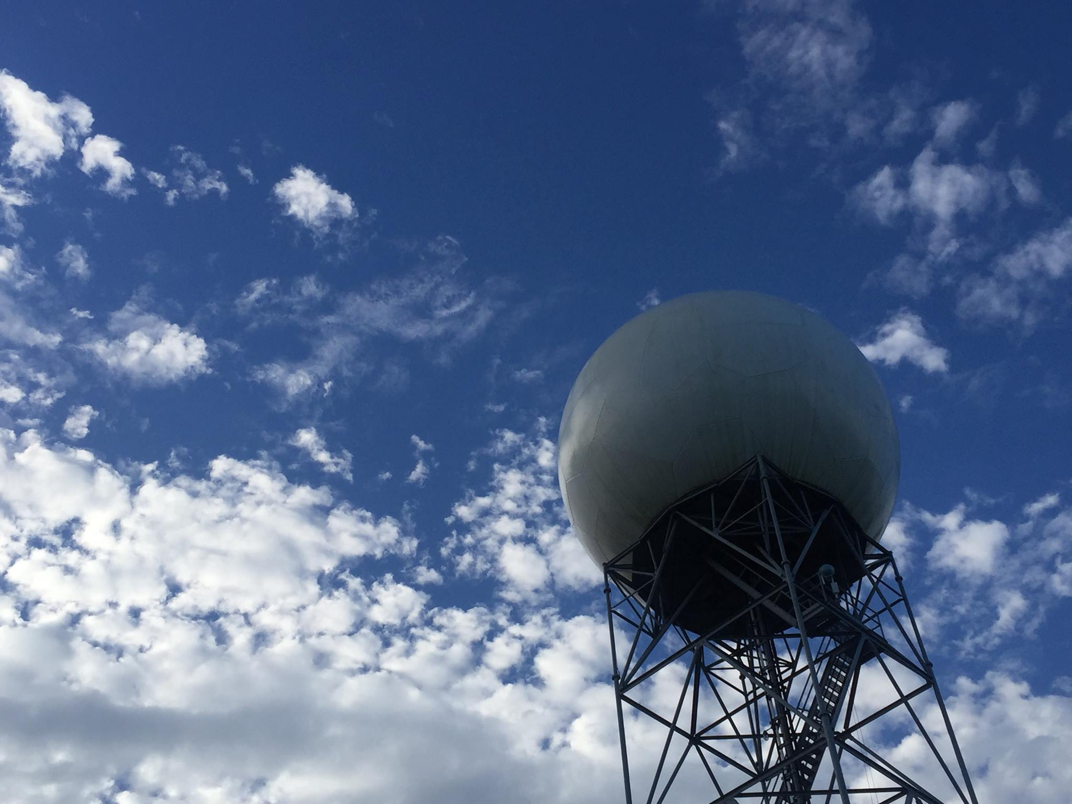
Instrumentation
1
Radiosonde/rawinsonde
Thermometer
Hygrometer
Anemometer
Rain gauge
Barometer
Radar
Satellite
3
2
5
4
8
6
7

Slide 9
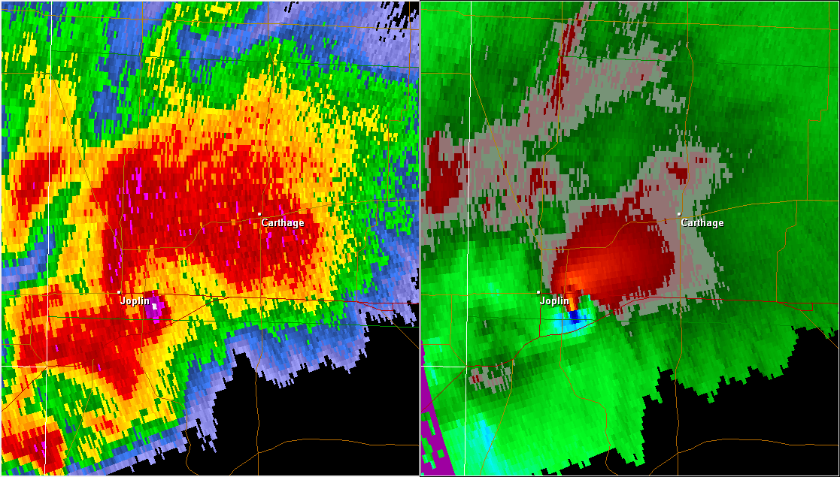
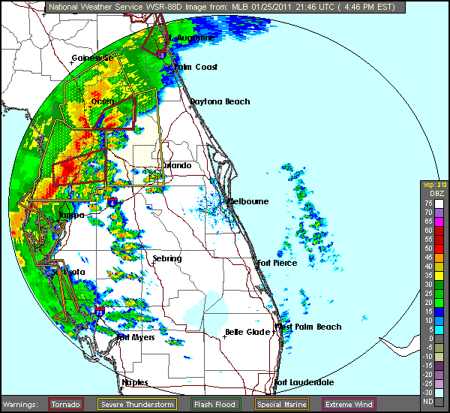
Radar Review
Joplin, MO EF-5 tornado (May 22, 2011)
Sends out electromagnetic pulse and listens
Bounces off rain, dust, bugs, birds, hail, etc.
Energy returned will depict “echoes” on radar imagery
Can indicate hail, debris, wind direction/speed, total rainfall, and many more
Limitations: can be blocked by buildings and landscape, cannot se directly below, limited to a radius
NWS Melbourne squall line (January 25, 2011)

Slide 10
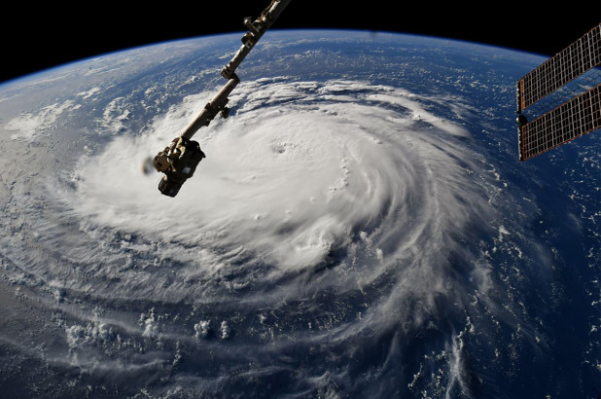
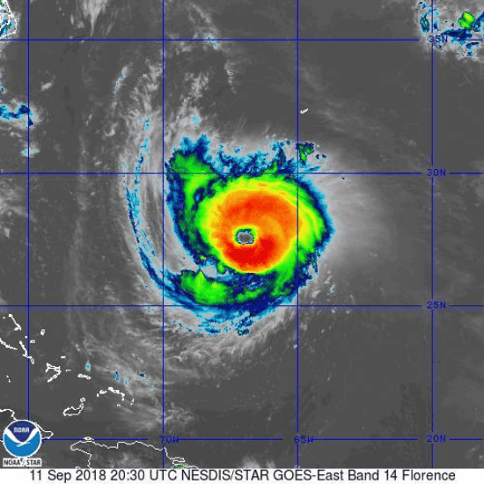
Satellite Review
Hurricane Florence!
Visible: viewing the sunlight reflected off Earth
Limitation: cannot use at night
Can tell cloud thickness if it is very reflective
Infrared: several channels! Senses re-emitted radiation
Longwave IR: cloud top temp
Can be used 24 hours a day
Limitation: low clouds can blend in with ground.

Slide 11
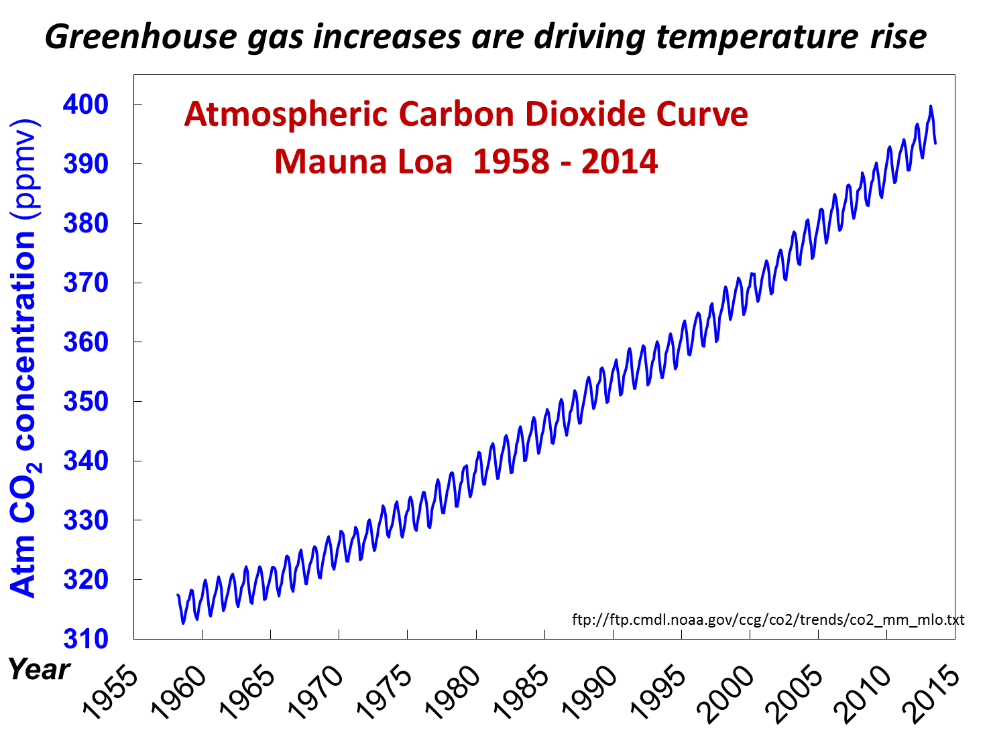
Early Earth Atmosphere
Early Earth Atmosphere:
After the oceans formed
-> CO2 dissolved into the water
->Sea creatures used CO2, water and sunlight to create carbohydrates with Oxygen as a byproduct (photosynthesis).
-> Oxygen lead to the formation of the ozone layer which is vital for land life
Carbon Dioxide (CO2) in the Atmosphere:
Most talked about GHG
Seasonal Fluctuations due to
vegetation uptake and release
General increase overtime
correlated to rise of temperatures

Slide 12
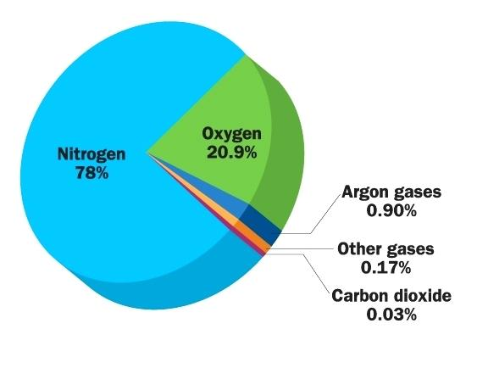
Earth’s Atmospheric Composition
Which are variable, permanent, trace, and noble?
Other gases:
Water vapor
Sulfur Dioxide
Ozone
Formaldehyde
Nitrogen Dioxide
Methane
Carbon Monoxide
Neon
etc etc etc…

